Slide 1



ML Project – “Airline Passenger Satisfaction”
- Presented By “Nutan Zine”.

Slide 2

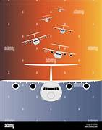

In the airline industry, passenger satisfaction plays a critical role in customer retention, brand reputation, and overall business success. Airlines collect extensive feedback through surveys and operational data, but manually analyzing this data is time-consuming and inefficient. The goal of this project is to develop a machine learning model that can predict passenger satisfaction based on various factors such as flight experience, in-flight services, seat comfort, food & beverage quality, baggage handling, check-in service, and other relevant attributes. By accurately predicting passenger satisfaction, airlines can: Identify key factors affecting customer experience. Improve service quality and operational efficiency. Personalize services to enhance customer loyalty. Make data-driven decisions to optimize resources.
Problem Statement: “Airline Passenger Satisfaction Prediction”

Slide 3


Build a classification model to predict whether a passenger is "satisfied" or "dissatisfied" based on available data.
Analyze feature importance to understand which factors significantly impact satisfaction.
Evaluate model performance using suitable metrics like accuracy, precision, recall, and F1-score.
Provide actionable insights to help airlines improve customer experience.
Objectives

Slide 4




Dataset Columns
There are Total 25 Columns in “Airline Passenger Satisfaction”
1. Unnamed : 0 2. id
3. Gender 4. Customer Type
5. Age 6. Type of Travel
7. Class 8. Flight Distance
9. Inflight wifi 10. Departure/Arrival time
service convenient
11. Ease of 12. Gate location
online booking 14. Online boarding
13. Food and drink 15. Seat comfort
16. Inflight entertainment 17. On board Service
18. Leg room service 19. Baggage handling
20. Checkin service 21. Inflight service
22. Cleanliness 23. Departure Delay in Minutes
24. Arrival Delay in Minutes 25. satisfaction

Slide 5




Table Of Contents -
STEPS TAKEN IN DATASET ANALYSIS AND MODEL BUILDING
1. Importing Data
2. Exploratory Data Analysis
3. Data Cleaning
4. Logistic Regression
5. Dicision Tree
6. Random Forest
7. SVM
8. K Nearest Neighbors
9. Choosing a K Value
10. Evaluation

Slide 6



EDA - Target Variable : satisfaction
Here, Univariate & Bivariate Analysis is done.

Slide 7




Graphs Used for Exploratory Data Analysis
1. Boxplot
2. Scatter Plot
3. Count Plot
4. Bar plot
5. Histogram plot
6. Heatmap

Slide 8


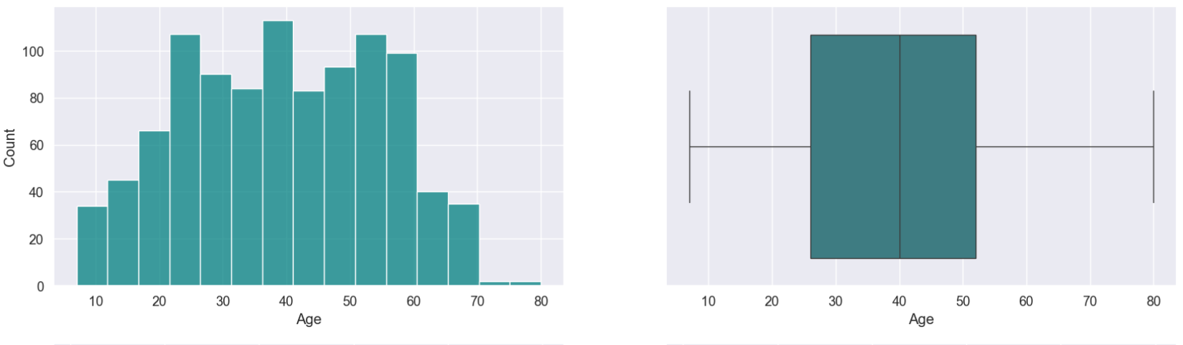
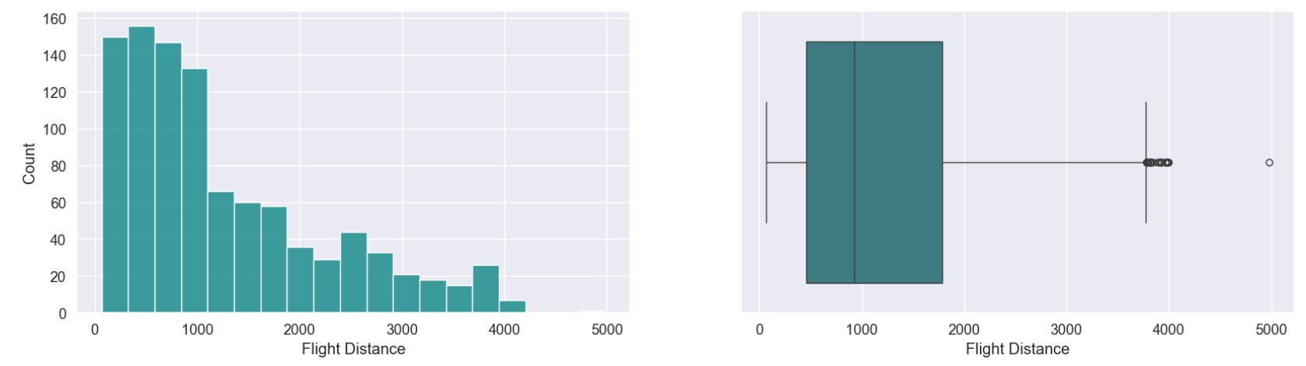
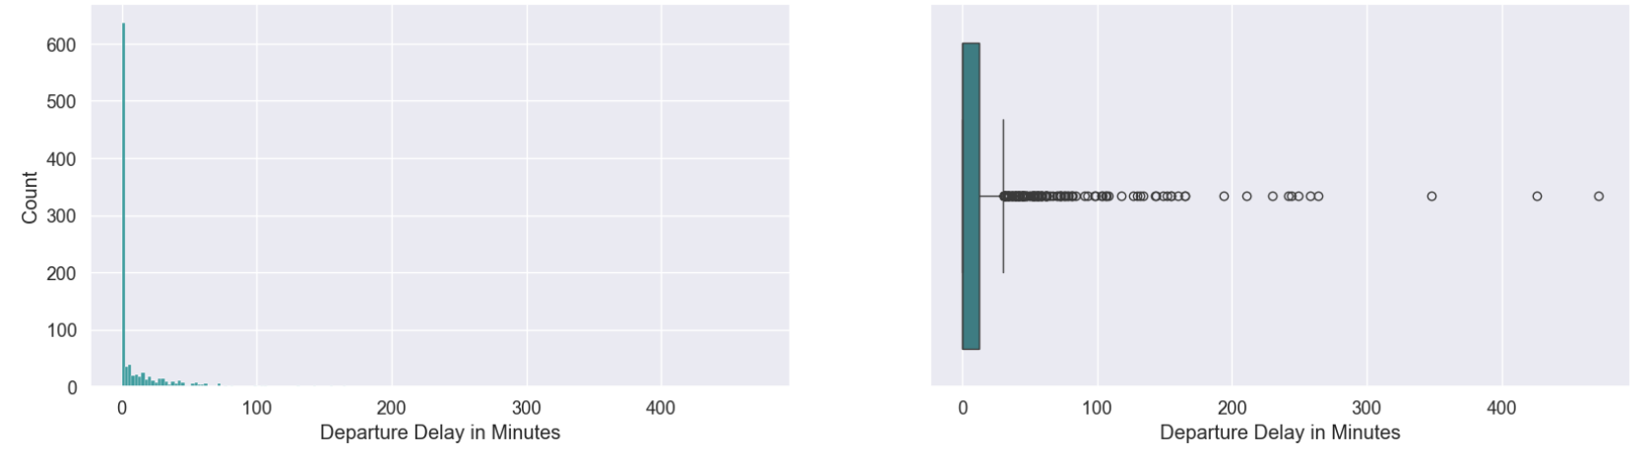
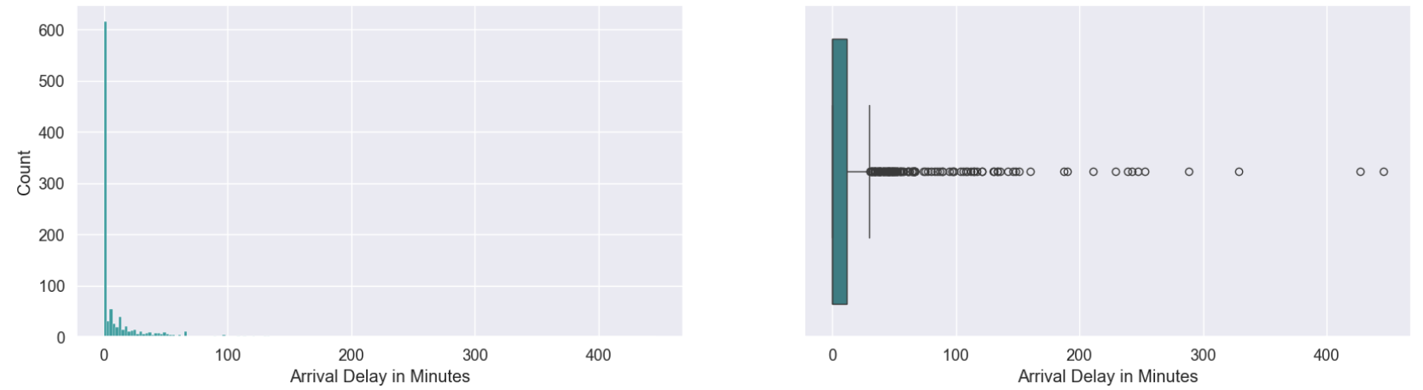
Event Design
Histogram & Box Plot are shown here

Slide 9


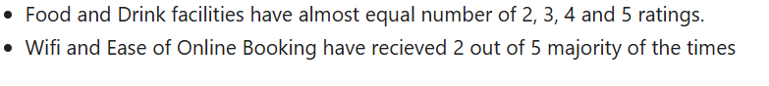
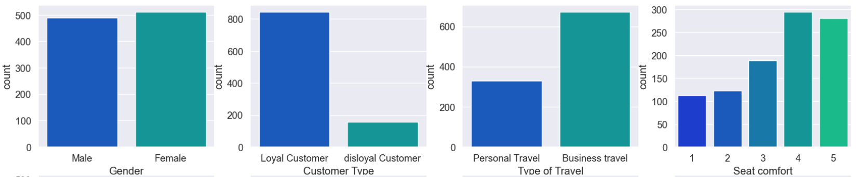
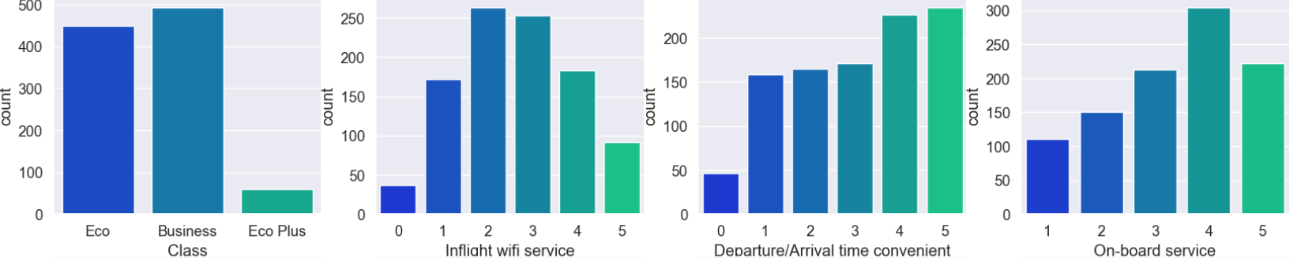
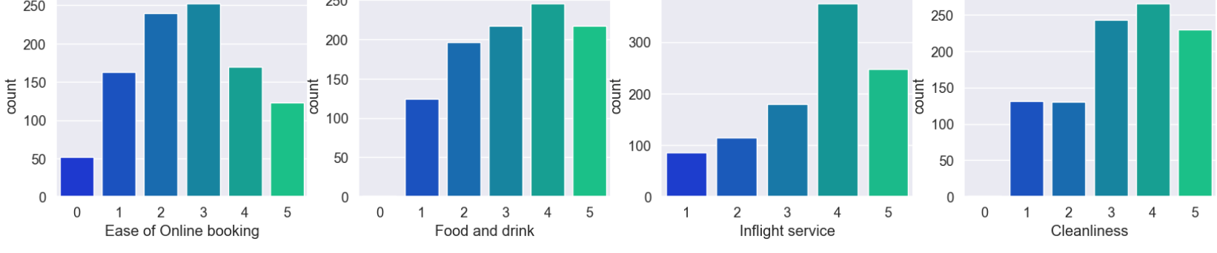
Event Design
Here, Count Plots are shown.

Slide 10


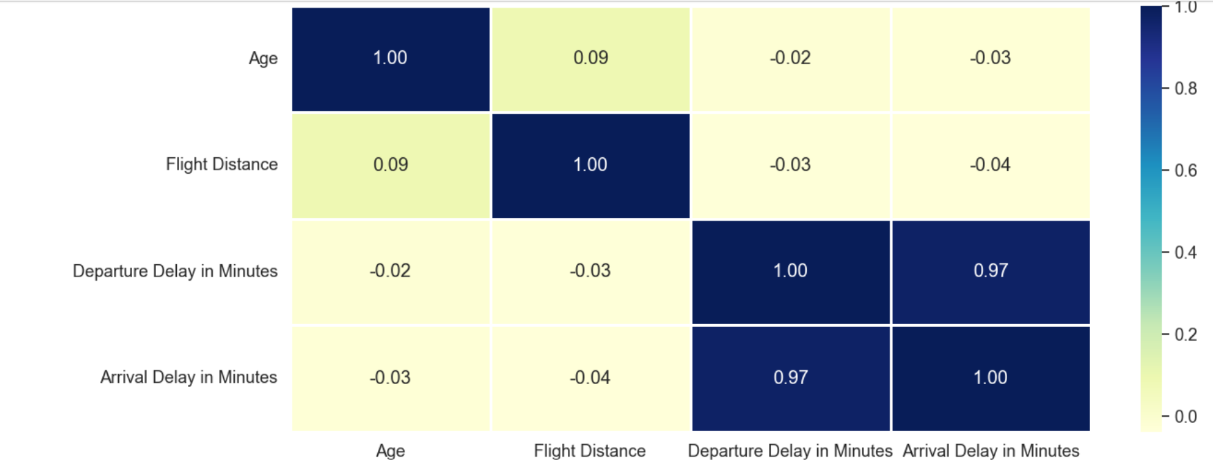
Event Design
Heat Map are shown here

Slide 11


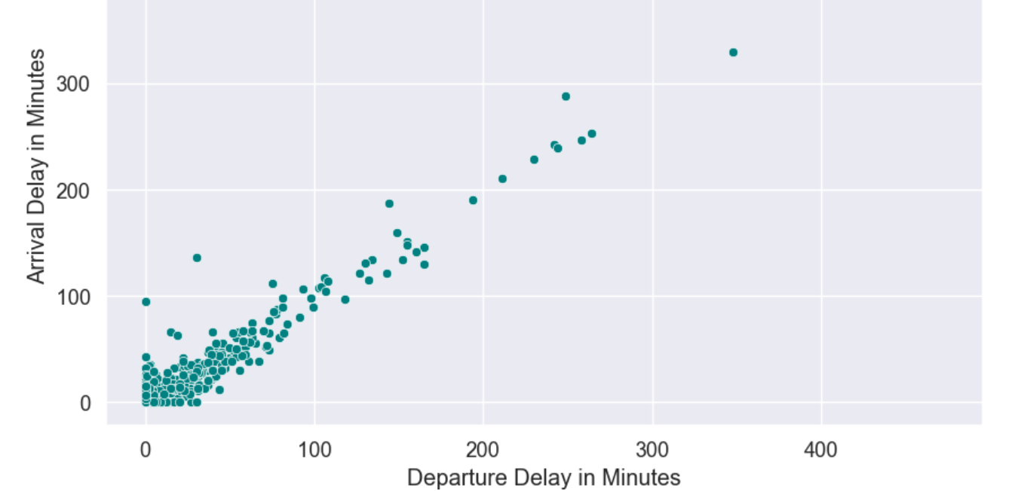
Scatter Plot are shown here.
Here, Departure & Arrival Delay in Minutes are shown by Scatter Plot.

Slide 12


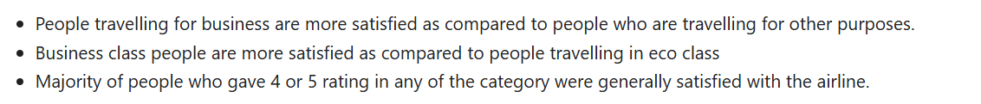
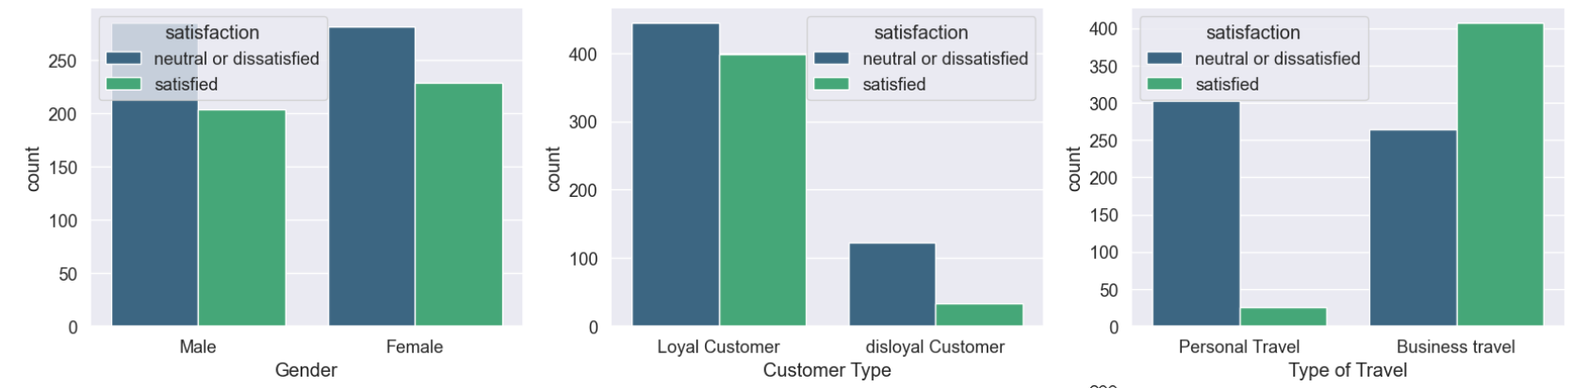
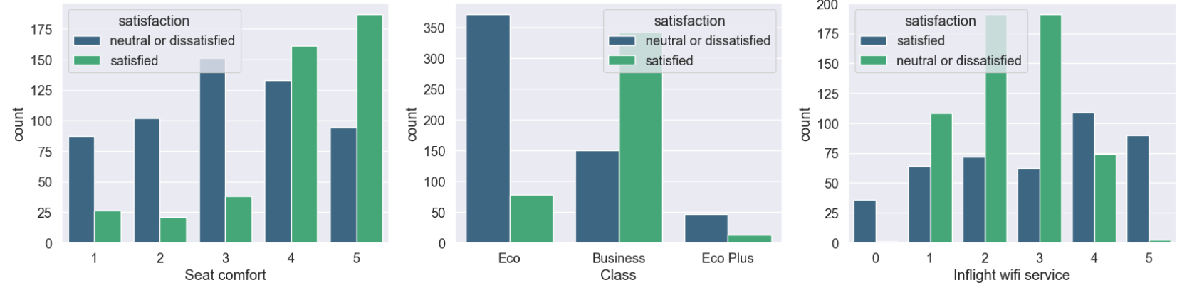
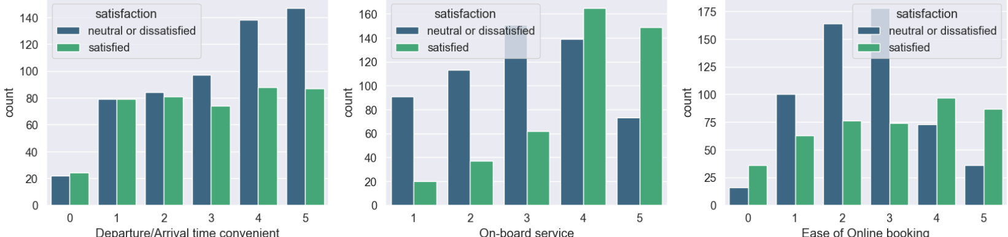
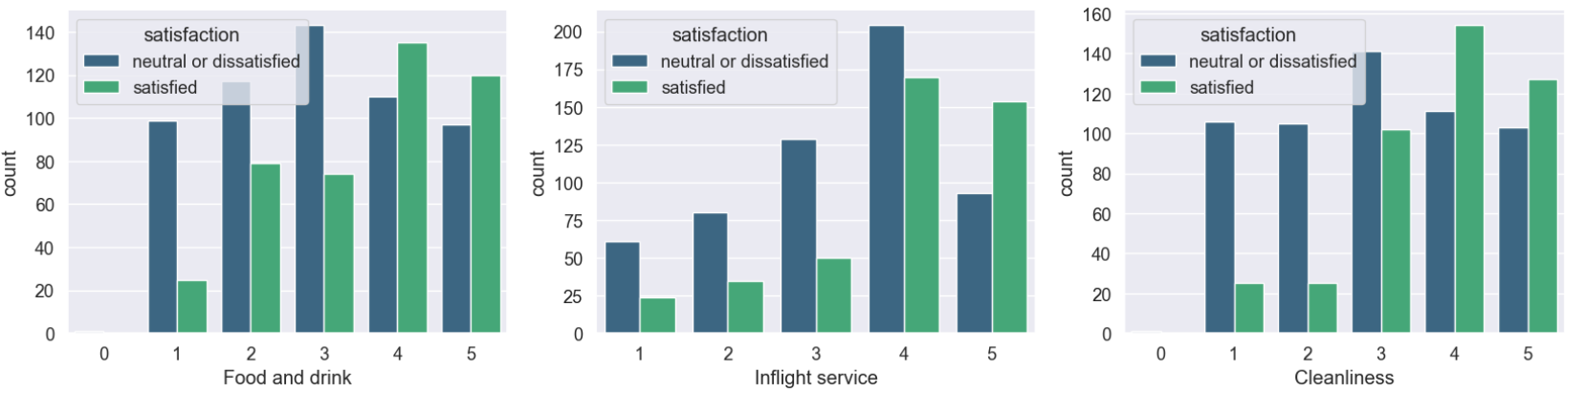
Count Plots are shown here

Slide 13




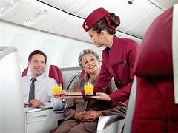
Here, Feature Transformation, Encoding & Feature Scaling are used.
Algorithms used :
1. Logistic Regression
2. Decision Tree
3. Random Forest
4. SVM
5. Naive-Bayes
6. K-Nearest Neighbors

Slide 14


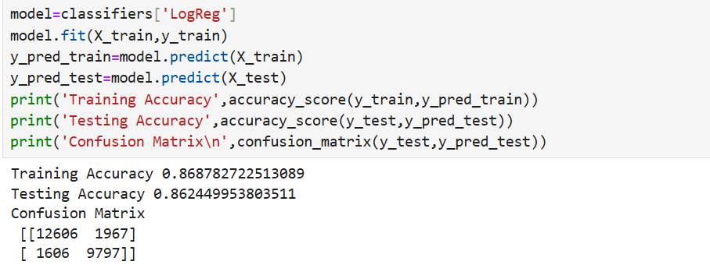
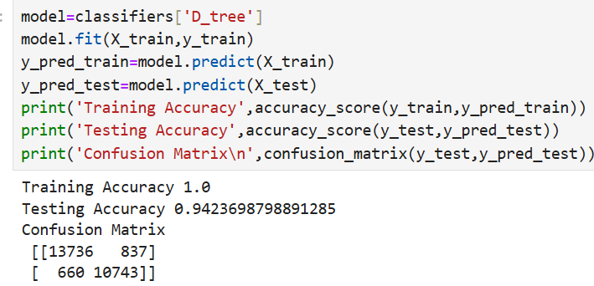
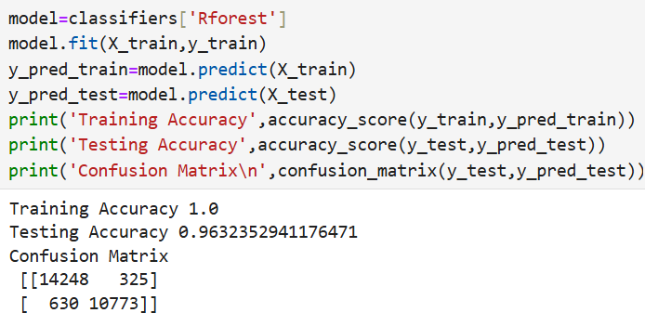
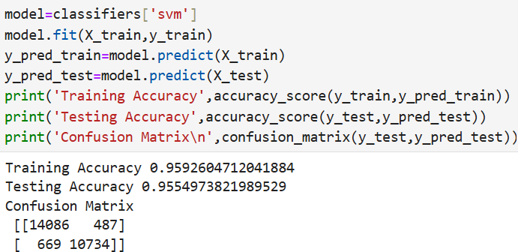
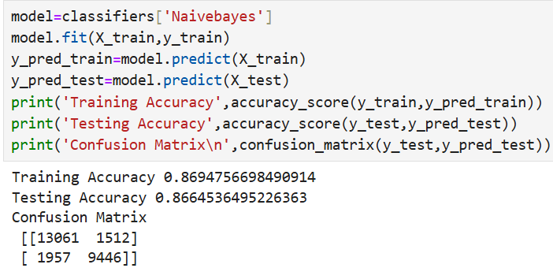
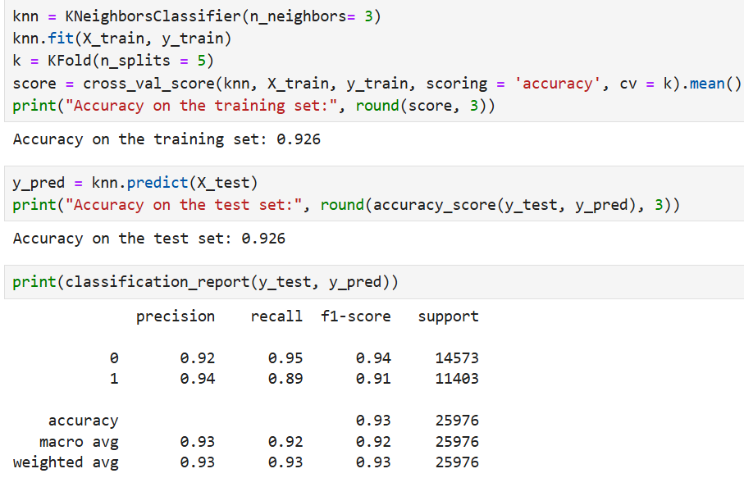
Algorithms & their Accuracy

Slide 15


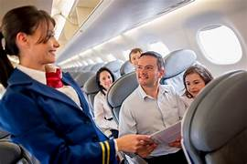
Conclusion
1.From The above slide we can say that Logistic Regression, Decision Tree, Random Forest Classifier, SVM, Naïve Bayes & K Nearest Neighbors are giving good Accuracy .
2. But, the Decision Tree, Random Forest Classifier & SVM gives Best Accuracy.
3. Precision, Recall, F1-Score, & Support are Good in K Nearest Neighbors Algorithm.
4. Accuracy Of Training & Testing Set Score is 92.6%. i.e. Our Model have Good Training & Testing Accuracy.

Slide 16
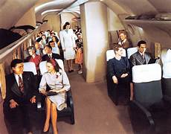

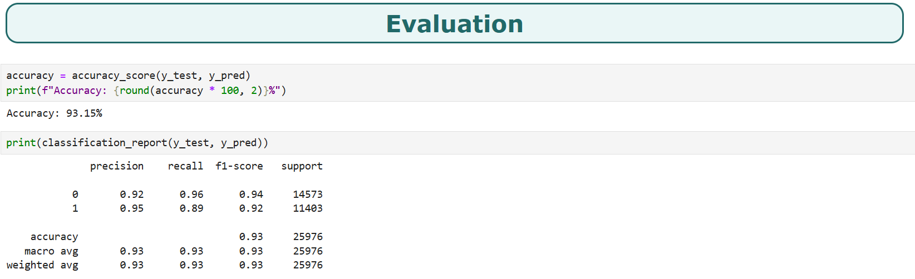
Evaluation
From The Below Evaluation slide, we can say that Precision, Recall, F-1 Score & Support is Good for our Model . Class 0 Recall Value is 96%. & Overall Accuracy Of our Model is 93.15%. So, Our Model has Good Accuracy. Our Model is Good to Perform.

Slide 17




Insights
On the Real – Time Data Analysis, Based on Target Column i.e. Satisfied. Here, Happy satisfied Passengers & Dissatisfied Or Neutral Passengers are shown by picture.
Dissatisfied Or Neutral Passenger
Satisfied Passenger

Slide 18


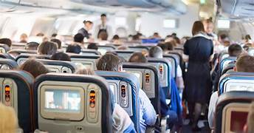
Future_Scope
Airline Service Optimization -
✅ Personalized Recommendations: Use ML to suggest personalized flight services based on past preferences. ✅ Dynamic Pricing Models: Adjust flight prices dynamically based on customer satisfaction trends. ✅ Route & Schedule Optimization: Analyze satisfaction data to improve flight scheduling and minimize delays.
✅ Improve All Passenger Satisfaction need that they want. E.g. Good
Service, Good Food & Beverages, Good Baggage Handlings, Comfort Seat shall be Provided. All Those Types of Needs are Provided for passenger Satisfaction.

Slide 19


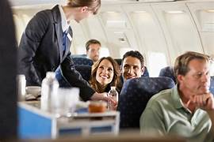
Best Algorithm For Prediction : Random Forest i.e. Training Accuracy : 100% & Testing Accuracy : 96%

Slide 20











